Slide 1
MyGEHealthCare

Slide 2
MyGEHealthCare
It’s all available with a single login and one seamless experience, allowing you to:
Access equipment utilization and performance analytics to guide workflow and equipment purchase decisions.
Create and track service requests via real-time push notifications for every step in the service process for your entire fleet.
View your organization’s equipment and parts orders.
Connect with training resources.
Safeguard your fleet with the latest cybersecurity updates.
Connect with your GE HealthCare team through one central point of contact.
The new, hassle-free way to manage your service and support from GE HealthCare in one place —anytime, anywhere.
Now you can get the answers you need, all in one place, with MyGEHealthCare. Whether you’re at your desk or on the go, MyGEHealthCare brings you comprehensive support and total equipment fleet visibility.

Slide 3

MyGEHealthCare
Desktop experience
The desktop experience of MyGEHealthCare brings you comprehensive, full life cycle support of any device in a unified experience now delivered through personalized dashboards and reports.
Sign up now
Get started and sign up now at www.gehealthcare.com/

Slide 4
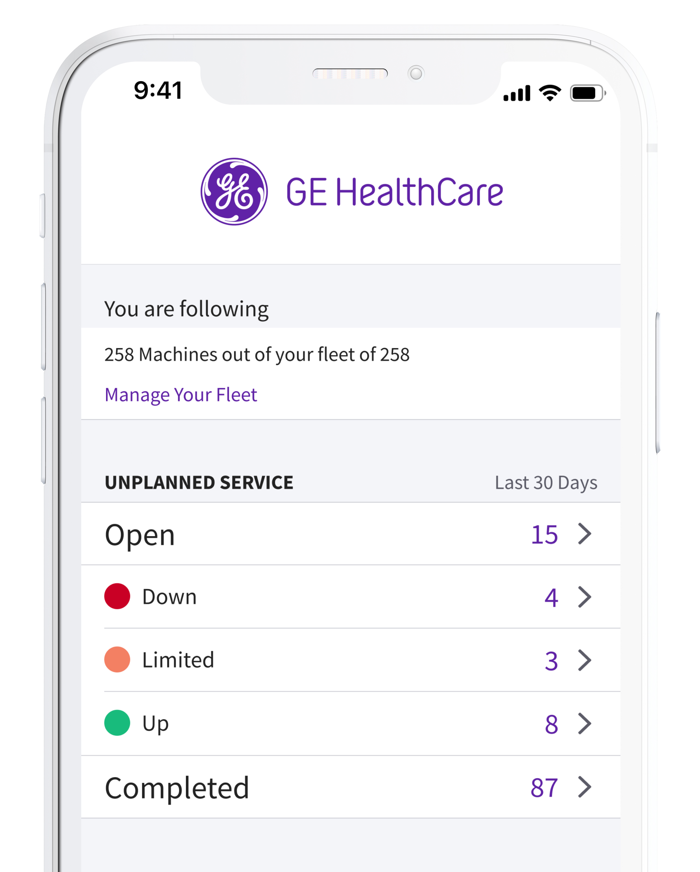

MyGEHealthCare
Mobile App
Stay up to date wherever you are. Real-time
bi-directional synchronization connects
the desktop and mobile platforms for a cohesive experience.
Download the mobile app from the Apple® or Google Play® stores by searching for MyGEHealthCare.
MyGEHealthCare app
Hassle-free way to manage your GE HealthCare service and support in one place—anytime, anywhere.

Slide 5
Account Home

Slide 6
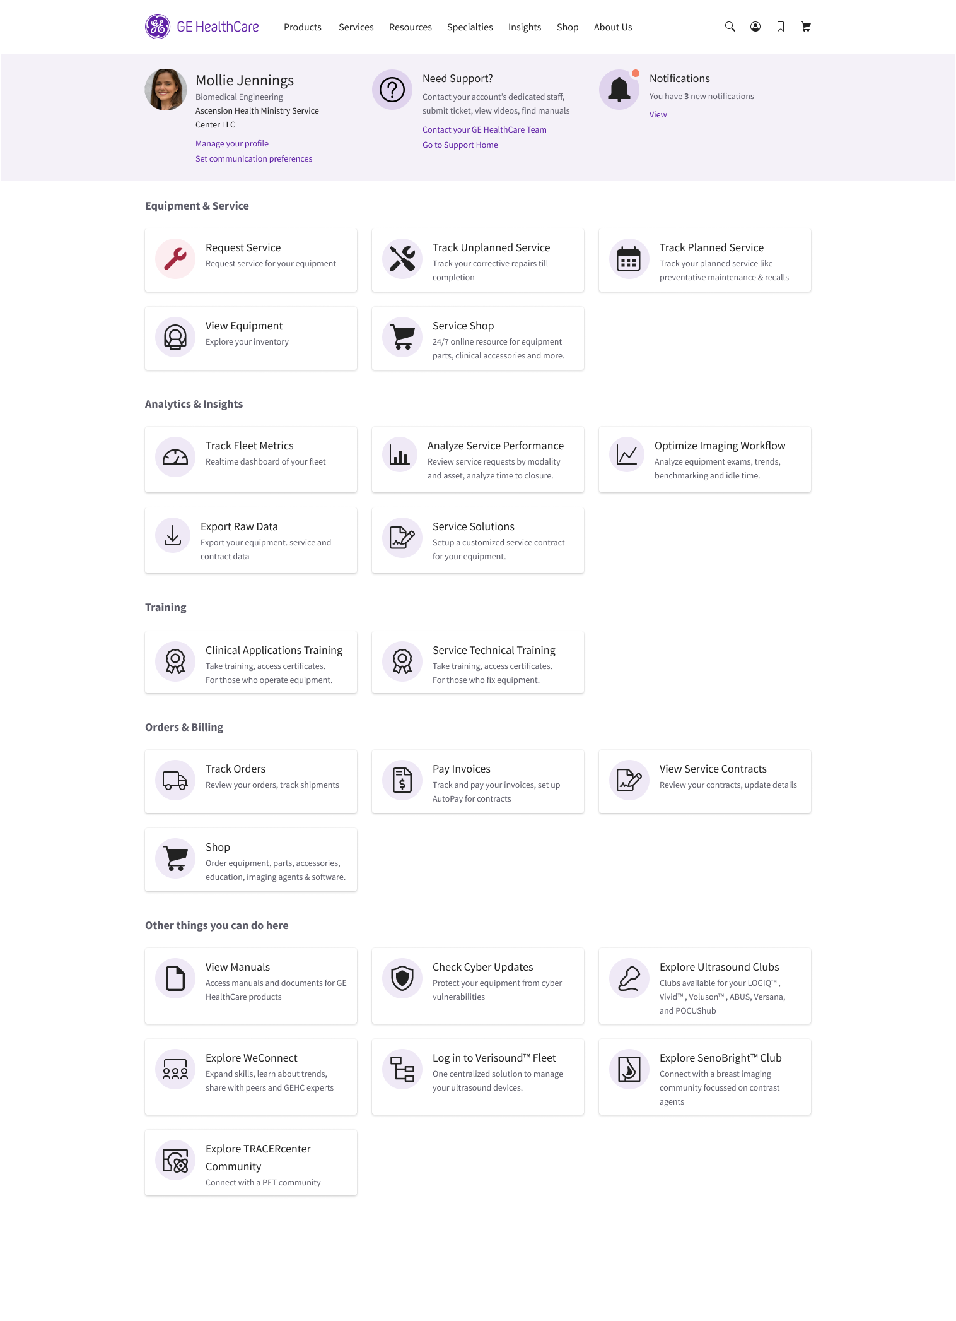
MyGEHealthCare Account Home
Account Home
Your direct connection for equipment, service, training, orders and invoices, analytics and insights.
Desktop view shown above

Slide 7
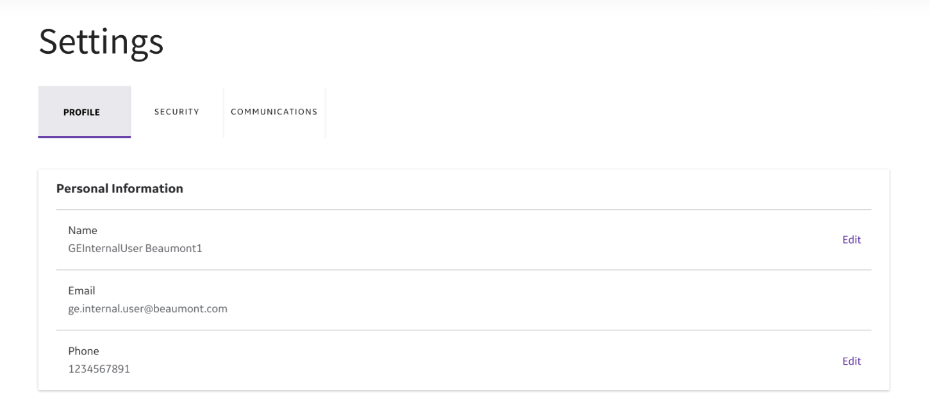
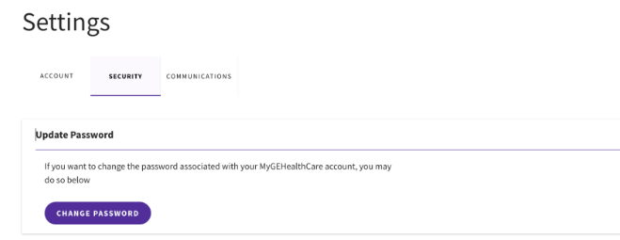
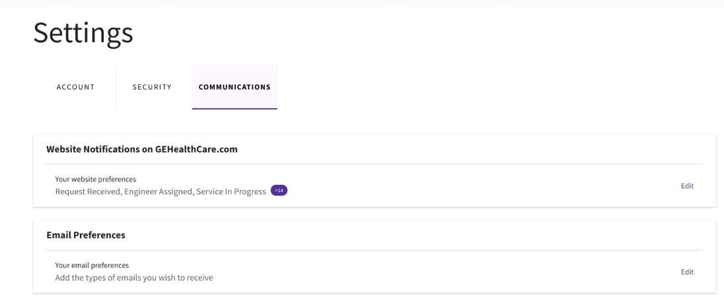
MyGEHealthCare Account
Account
Account Settings include customer information, password and notification settings to receive email.
Click Account to access more useful tools:
User Profile
Change password
Communications to receive
email notifications
1
2

Slide 8
Support

Slide 9
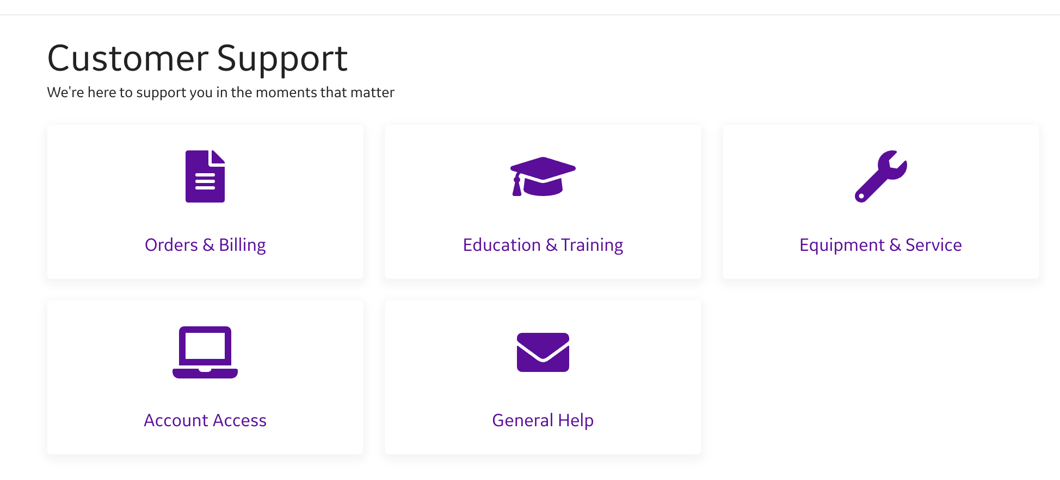
MyGEHealthCare Support
Support
Click Need Support to access more useful tools:
Orders & Billing
Education
Equipment & Service
Website & Account Access
General help
Service Shop Help

Slide 10
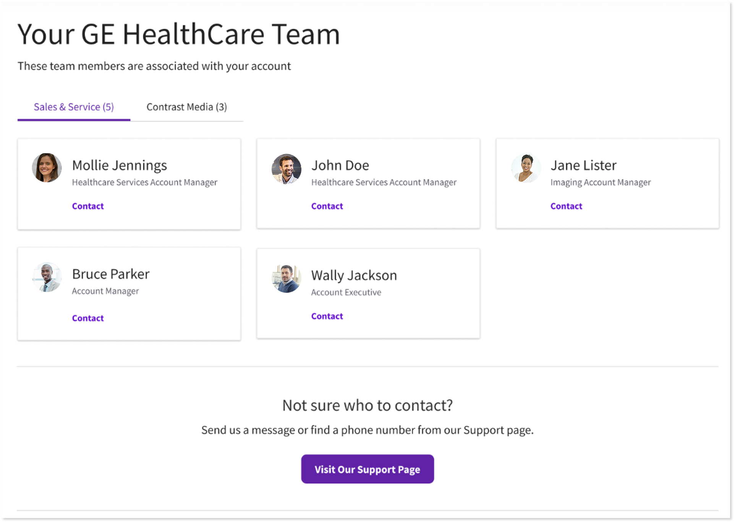
Support My Team
Contact your MyGEHealthCare Team
1
Click Contact your GE HealthCare Team
to view team members associated
with your account.

Slide 11
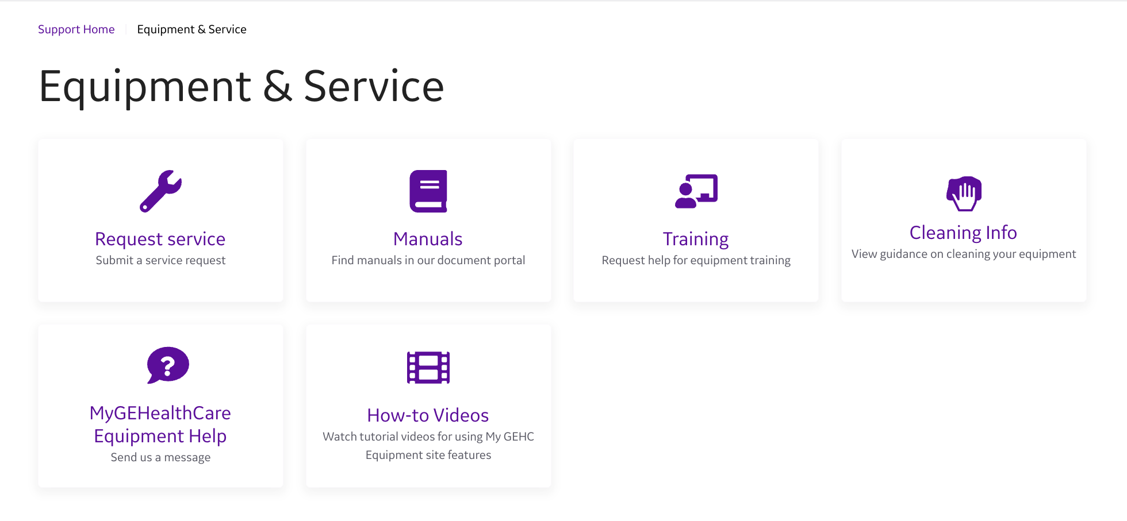
MyGEHealthCare Support
We're here to support you in the moments that matter.
Orders & Billing – Shop, track orders, pay invoices
Education – Training for operation and maintenance
Equipment & Service – Request service, shop, view service schedules
Website & Account Access – Manage account preferences
General Help – Access support
Service Shop Help – Request technical assistance

Slide 12
Equipment & Service

Slide 13
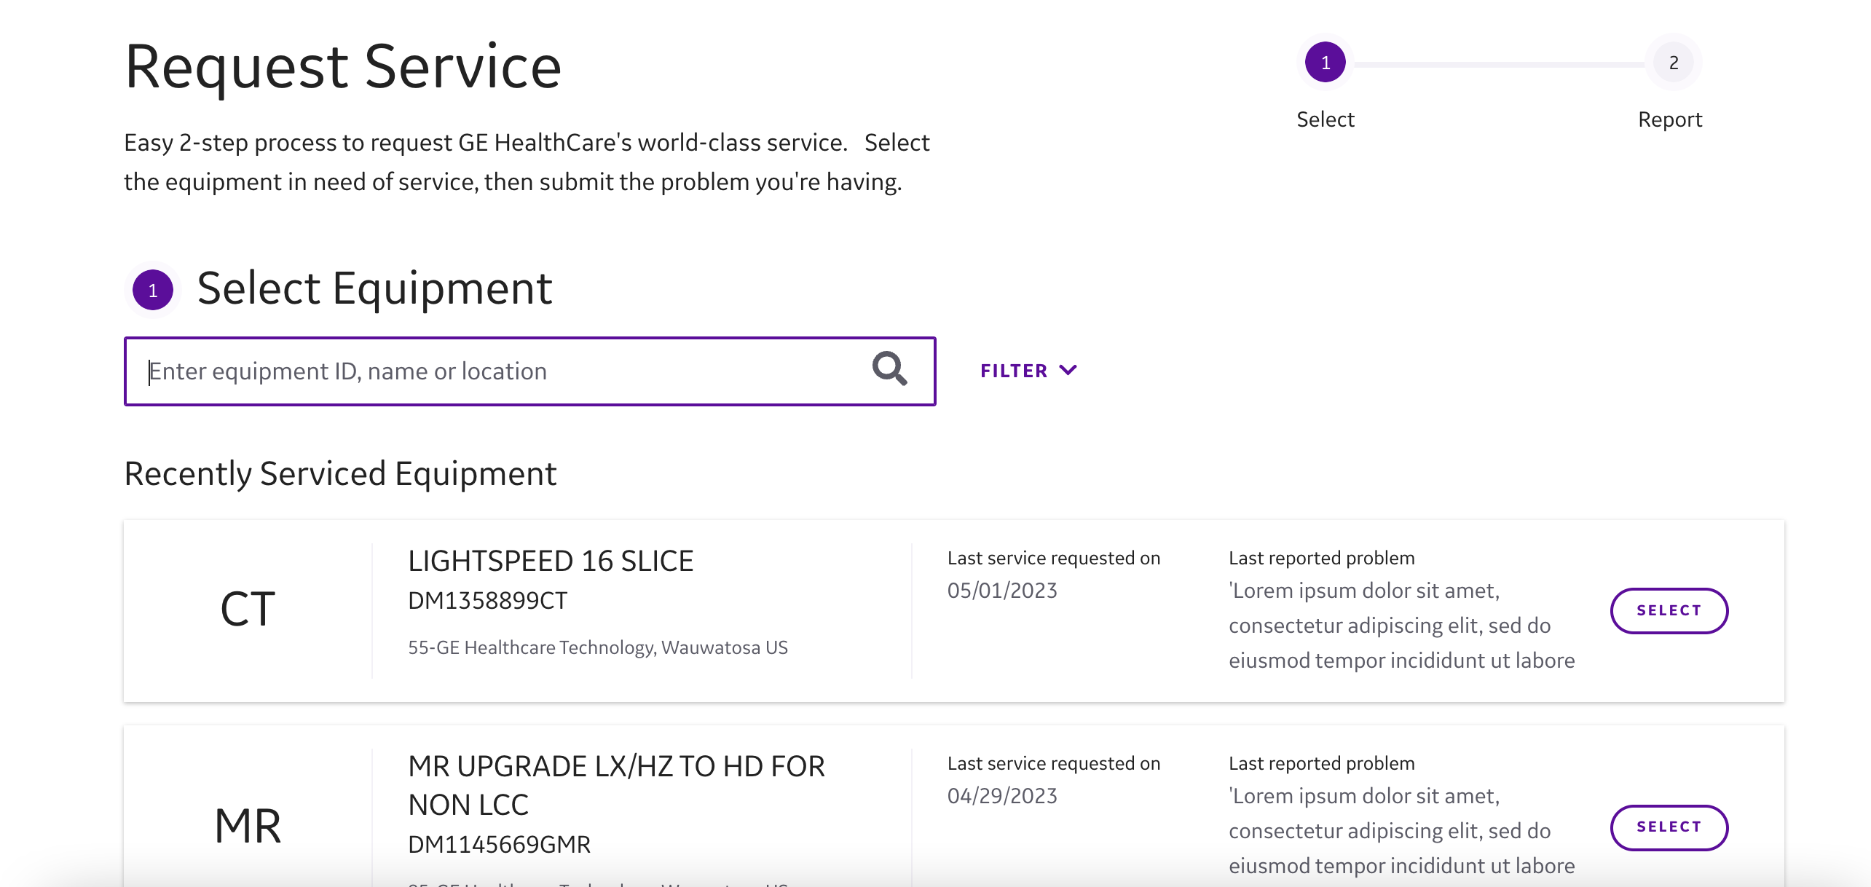
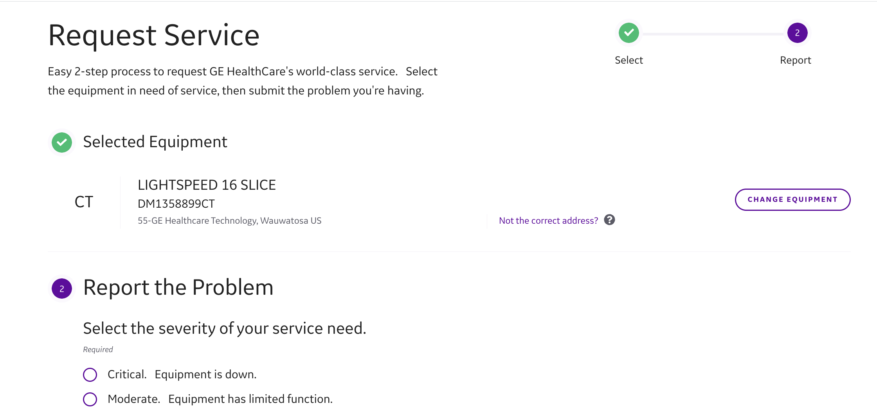
Request Service
Request service
From the Account Home, click the
Request Service button
Select the equipment by ID, name,
or location
Describe the problem and submit
1
2
3

Slide 14
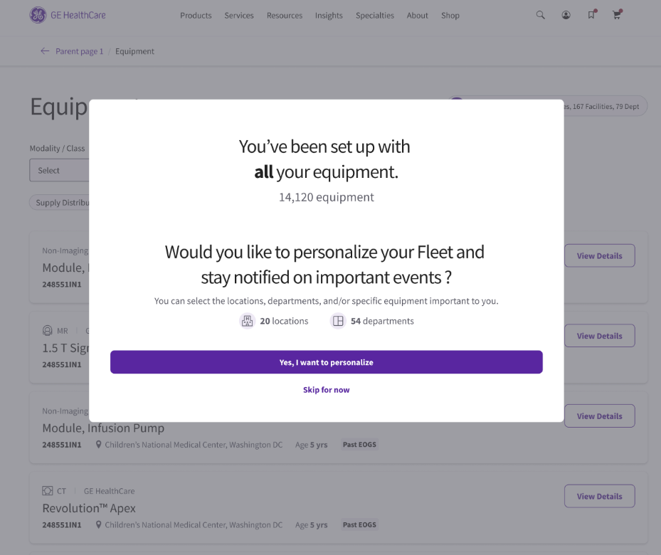
Fleet Settings
Fleet Setup
Upon first visit to View Equipment, MyGEHealthCare will lead you through
Fleet Settings to customize viewing your equipment inventory. You may update your customized view as equipment is added or removed over time.

Slide 15
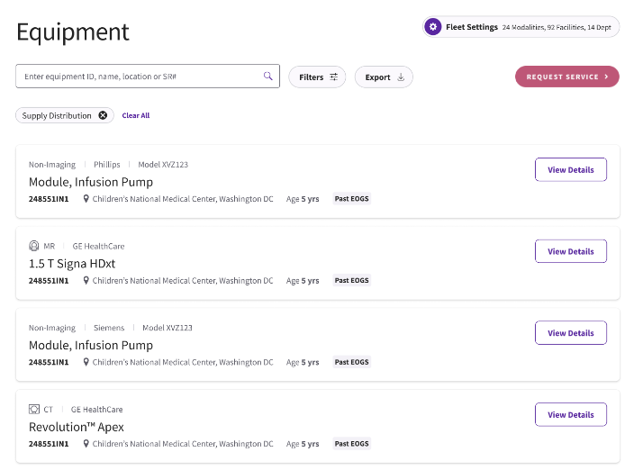
Fleet Settings
1
Fleet Setup
After initial setup, you can make further customizations to your Fleet at any time through this Fleet Settings button.
Desktop view shown above

Slide 16
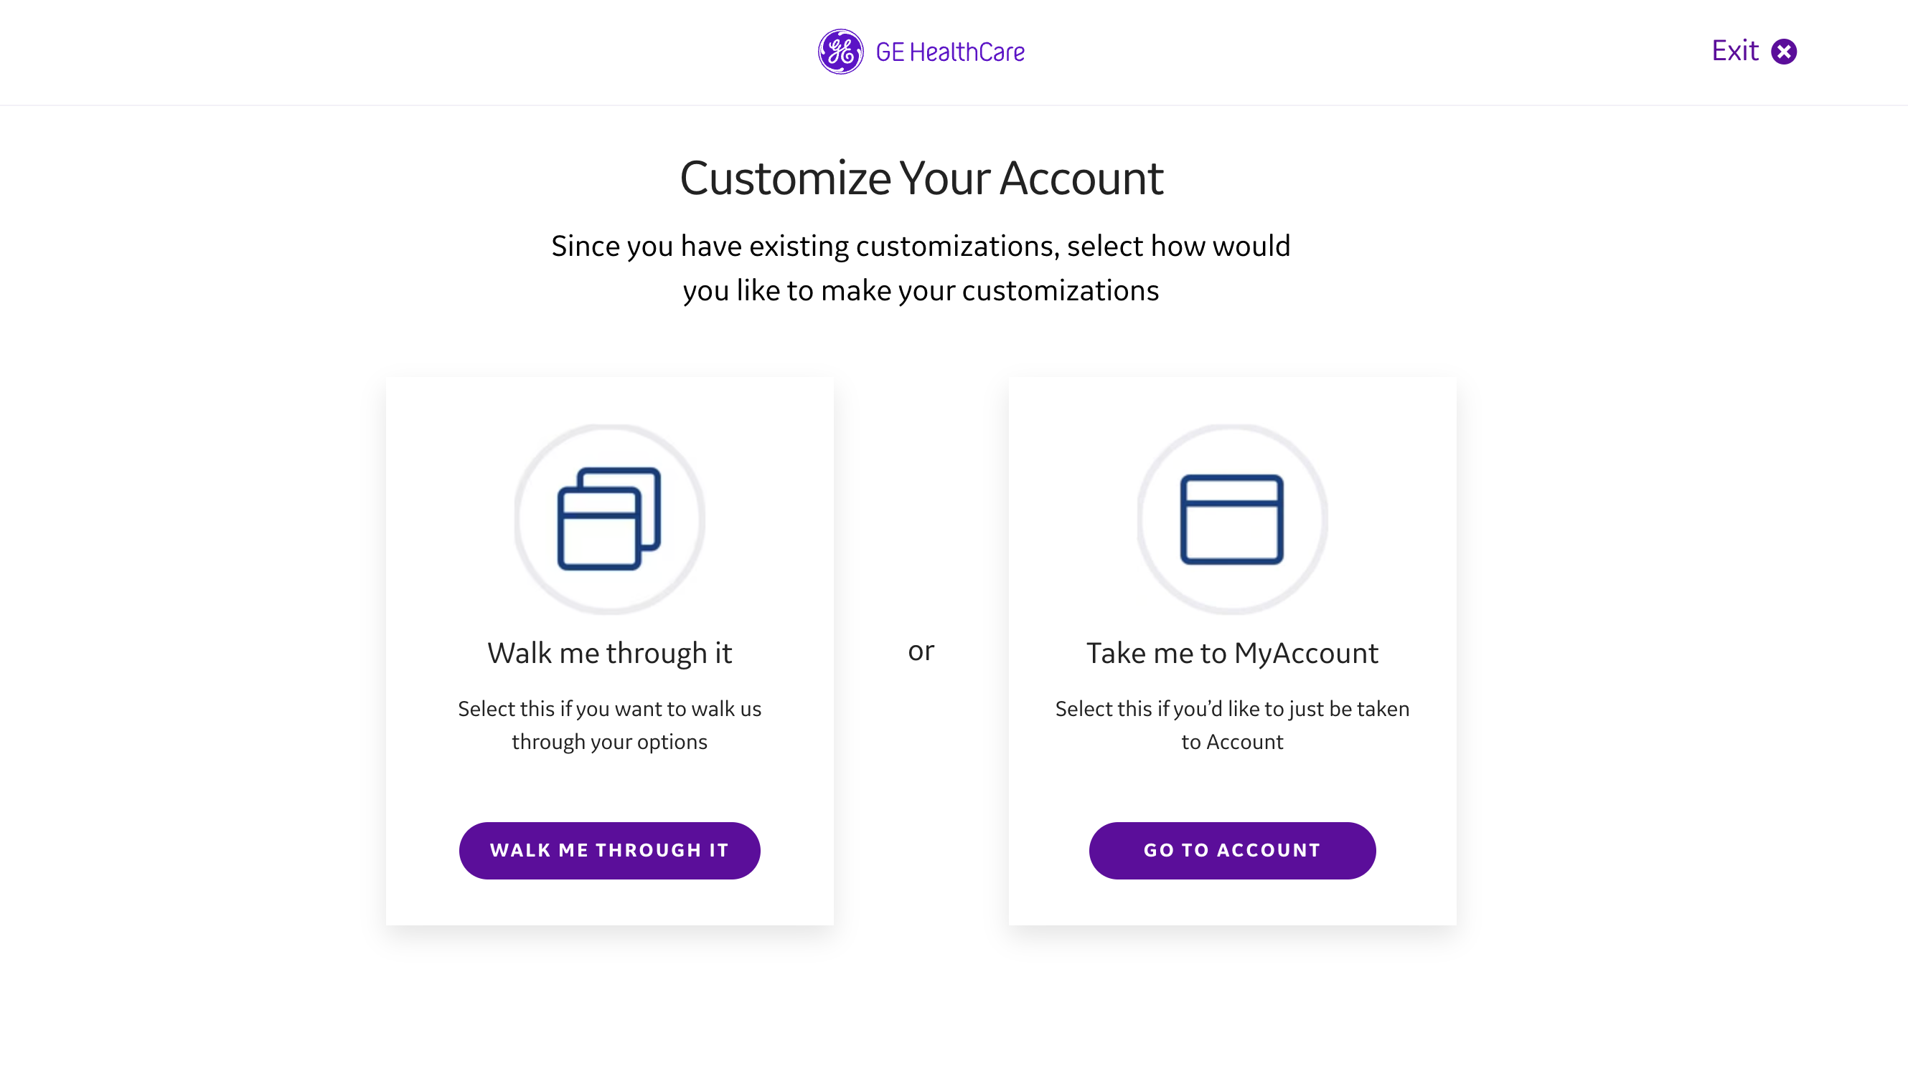
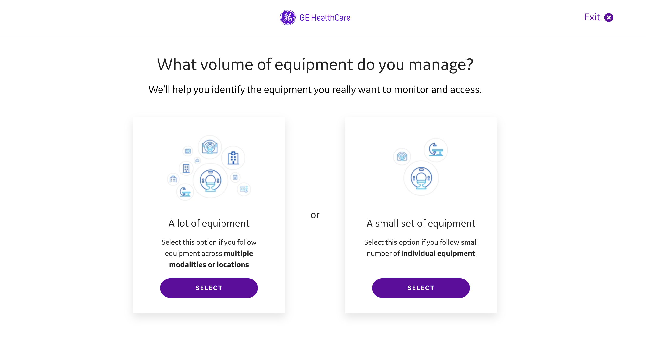
Fleet Settings
Describe your fleet
Let our prompts help you get started
Choose if your fleet is large or small
2
3

Slide 17
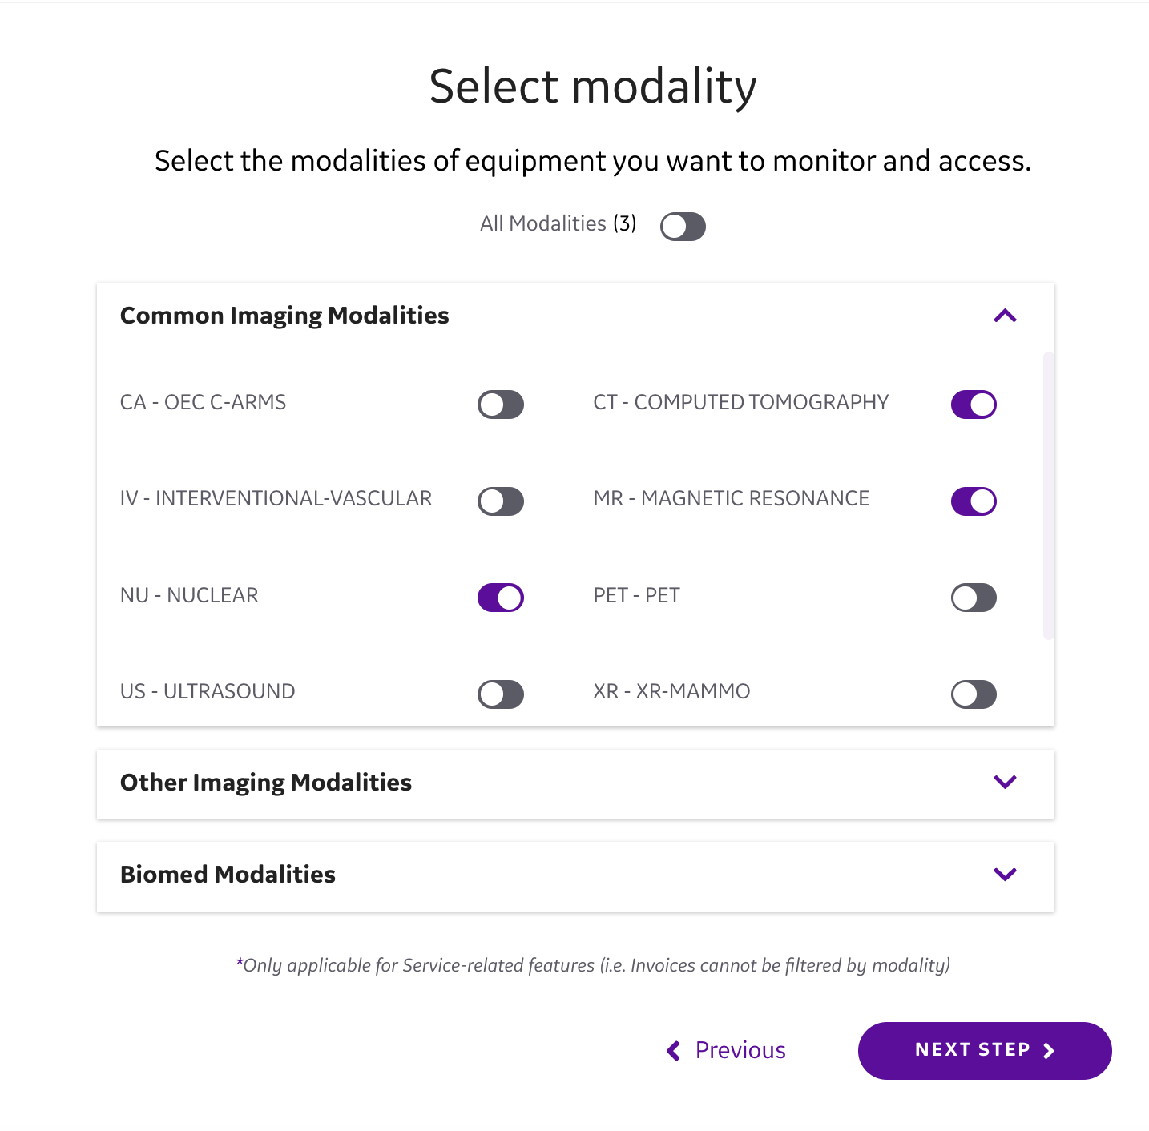
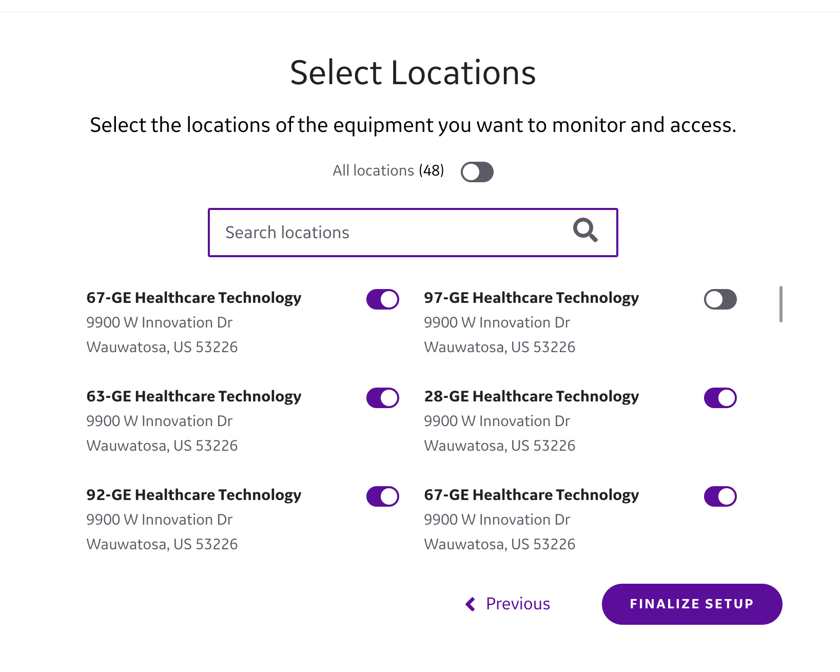
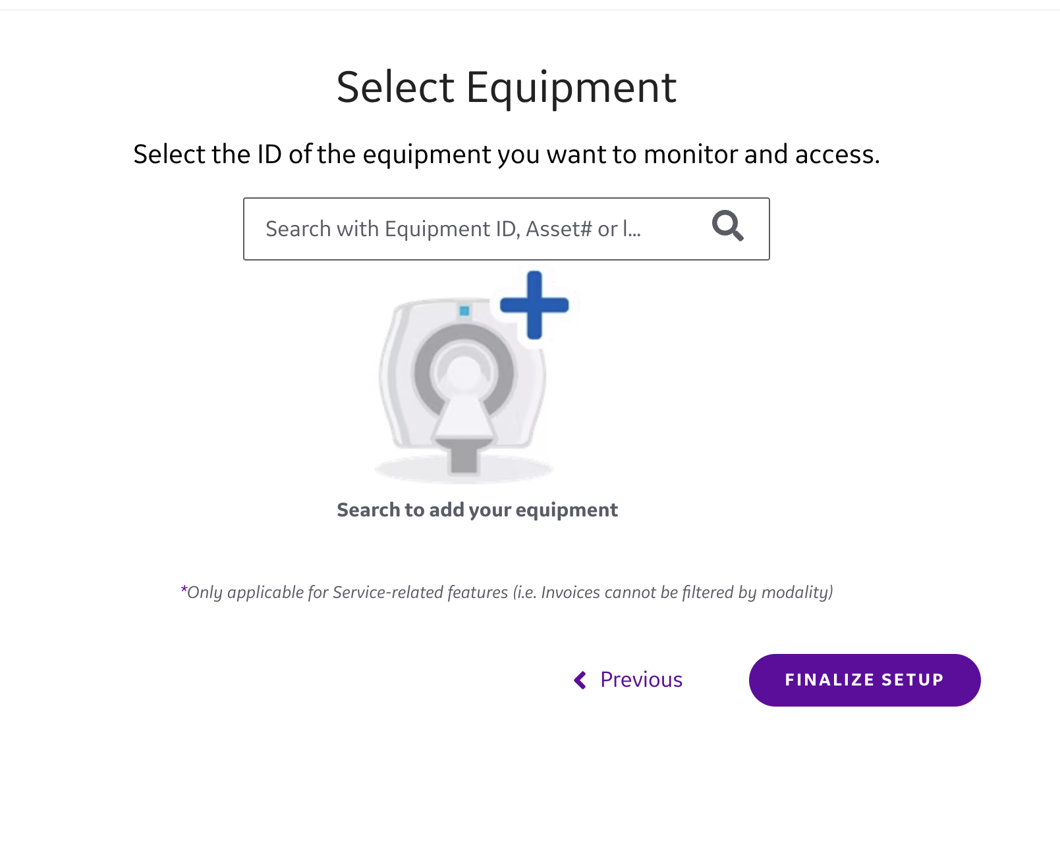
Fleet Settings
4
What equipment do you use?
Select the modalities of the equipment you want to monitor
Select the location of the equipment
Select Biomed equipment to finalize setup
5
6

Slide 18
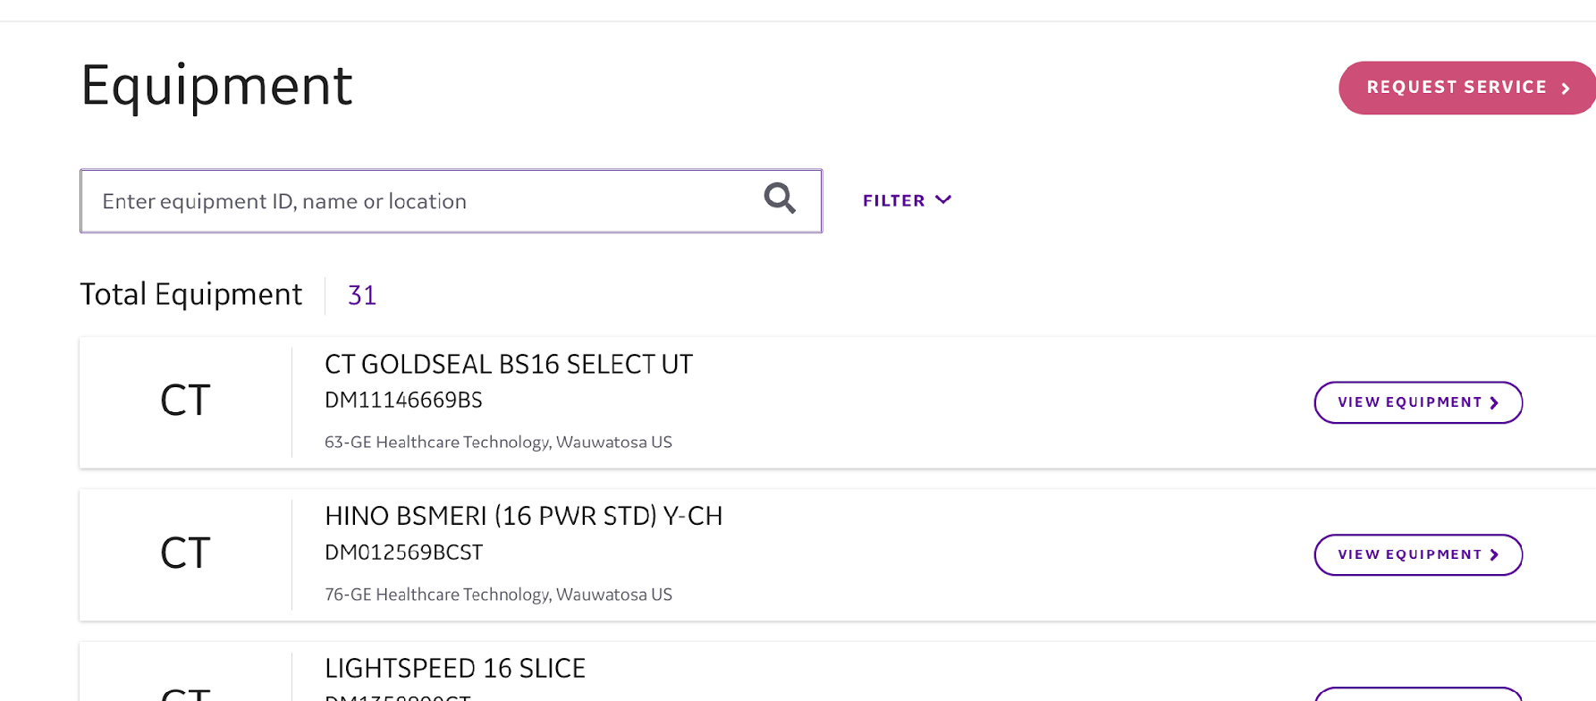
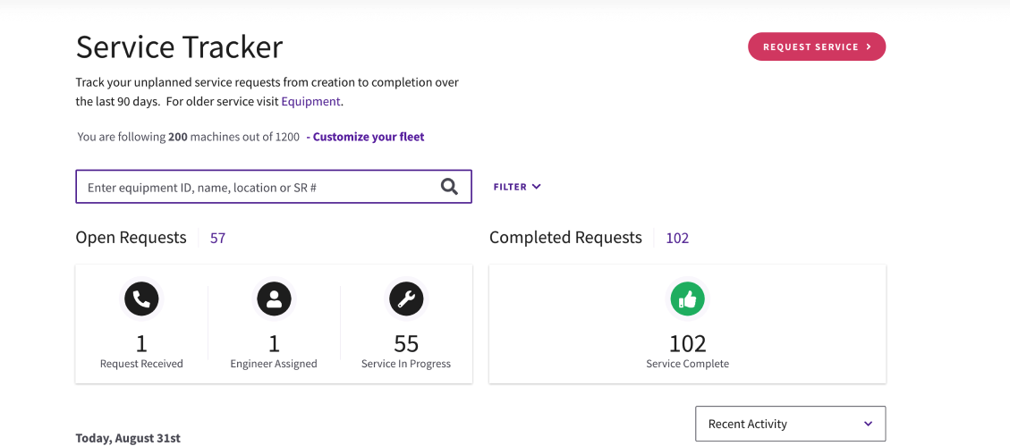
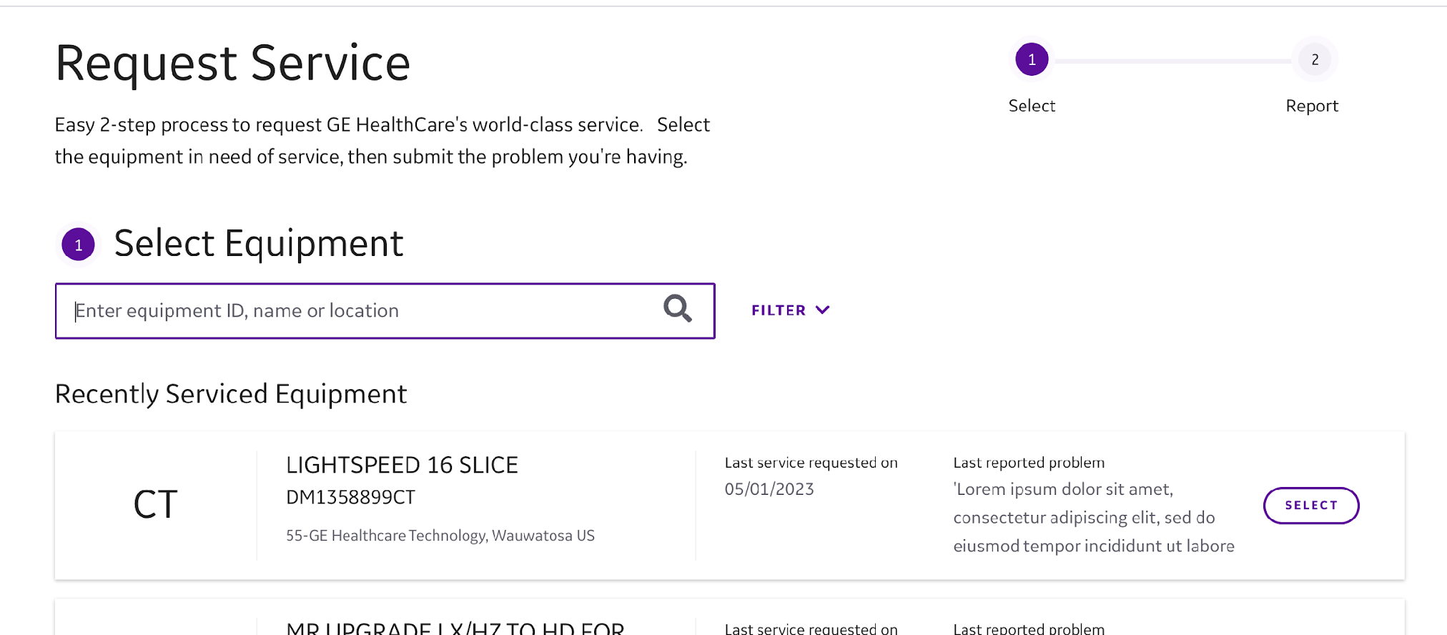
View Equipment
View Equipment functions
In this section, click View Equipment
to access more useful tools:
Equipment status
Track service requests and
scheduled maintenance
Request service
Service customers registered for MyGEHealthCare that have Biomed inventory loaded within Nuvolo can now proactively manage their entire biomedical fleet as well as diagnostic imaging.
!

Slide 19
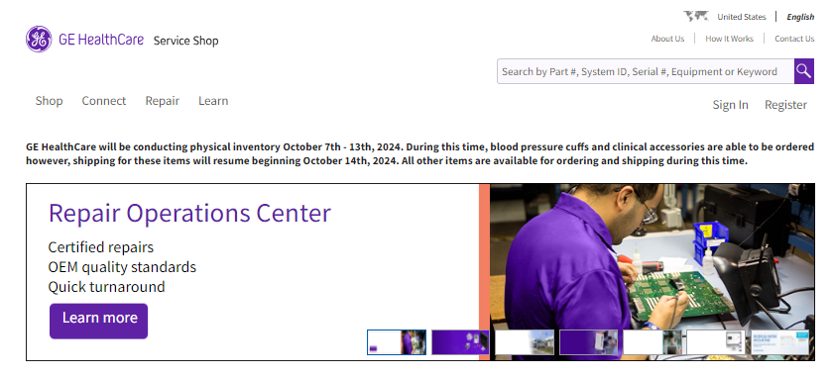
Service Shop
Your time is valuable. GE HealthCare Service Shop offers fast and convenient resources so you can stay focused on what matters—patient care. Designed to meet the growing service needs of your healthcare facility, Service Shop gives you direct access to 80,000 OEM-verified parts, accessories, and supplies. With mobile-friendly online ordering, you can place orders, check prices and availability, get identification assistance
with pictures and manuals, and more.
Fast. Flexible. Convenient.
Select from over 90,000 genuine GE HealthCare parts, accessories, and consumables across DI, OEC, and CCS modalities
Search by equipment and
view compatible products
with real-time inventory
Get contracted discount
pricing an easily purchased with a credit card or purchase order
Track orders online and
get shipment notifications
for better planning and logistics
Integrate into customer procurement systems (EPR, CMMS) to simplify workflow
Report spend histories with
simple customer reporting for each employee

Slide 20
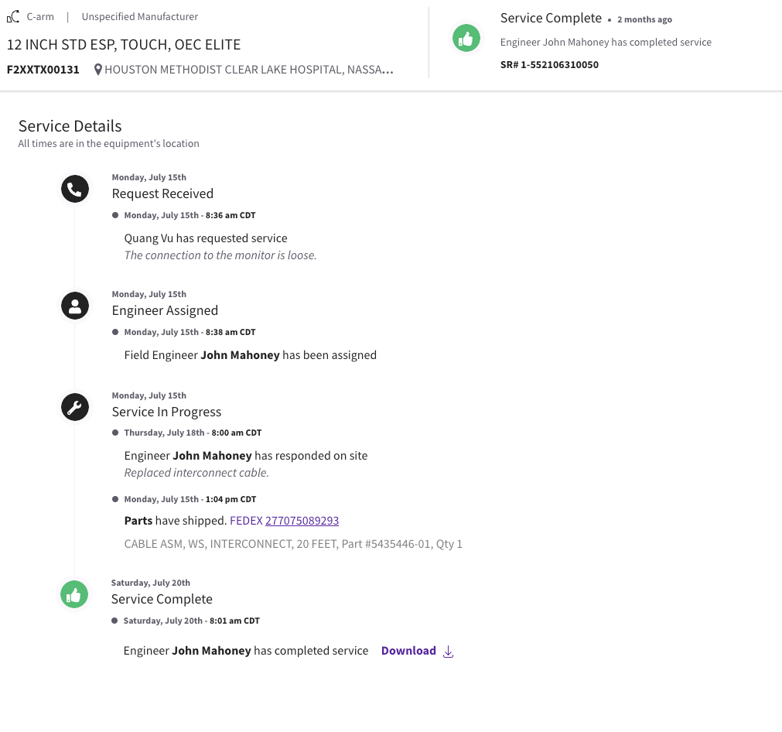
Parts Tracking
Parts Tracking
Within the Service Requests section, you can see a timestamp of when the order was placed and receive a notification when the part shipped.
Available for Diagnostic Imaging only
1

Slide 21
Analytics and Insights

Slide 22
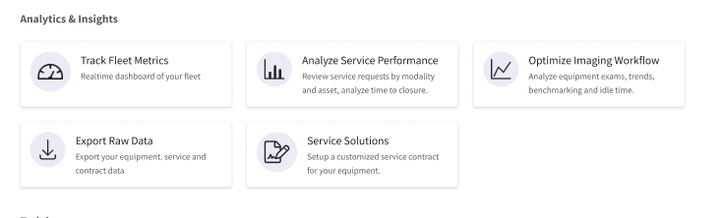
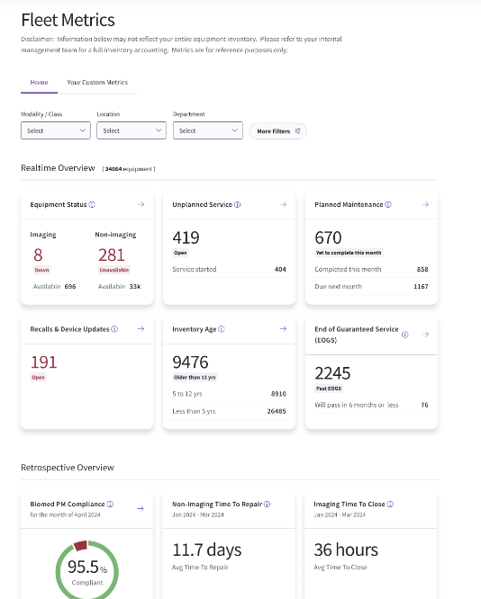
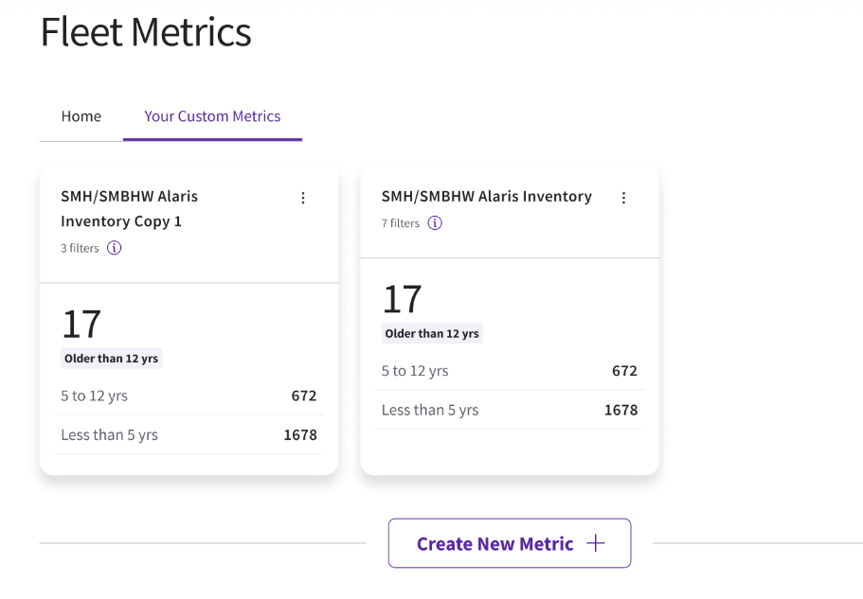
Track Fleet Metrics
!
Fleet Metrics
Realtime metrics for your fleet:
Review equipment status for your
imaging and non-imaging equipment
Insights into unplanned service events
Recall and device update information for scheduling
Full fleet view of inventory age from install through end of life
Ability to filter on key performance indicators
Download raw data
Create custom metrics for your individual needs
Available for Diagnostic Imaging Equipment and Desktop only

Slide 23
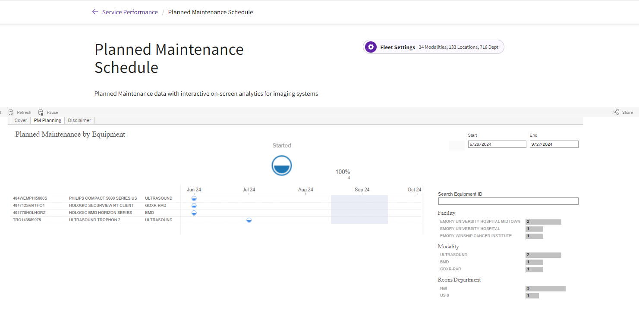
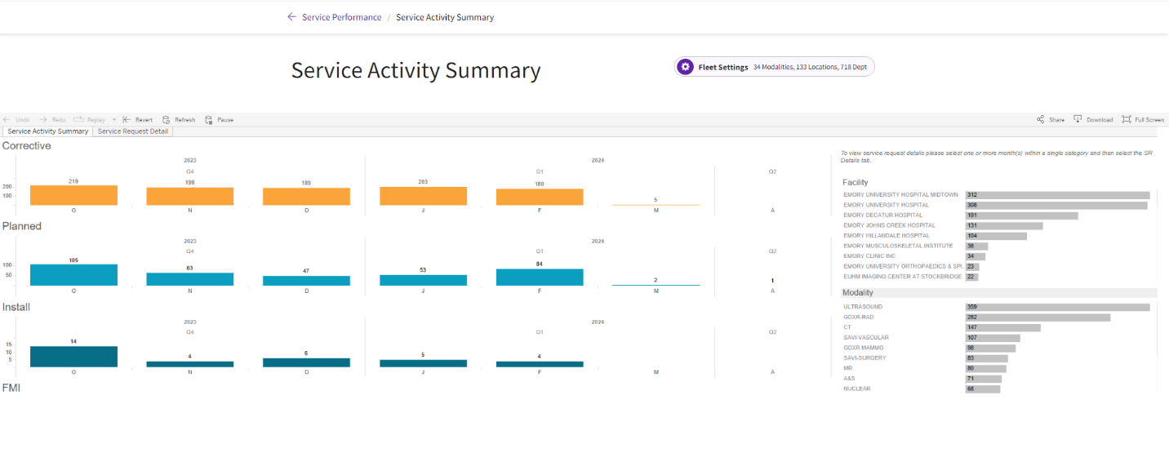
Analyze Service Performance
Service Performance
!
Review service requests by modality and asset and analyze time to closure.
Available for Diagnostic Imaging Equipment
and Desktop only

Slide 24
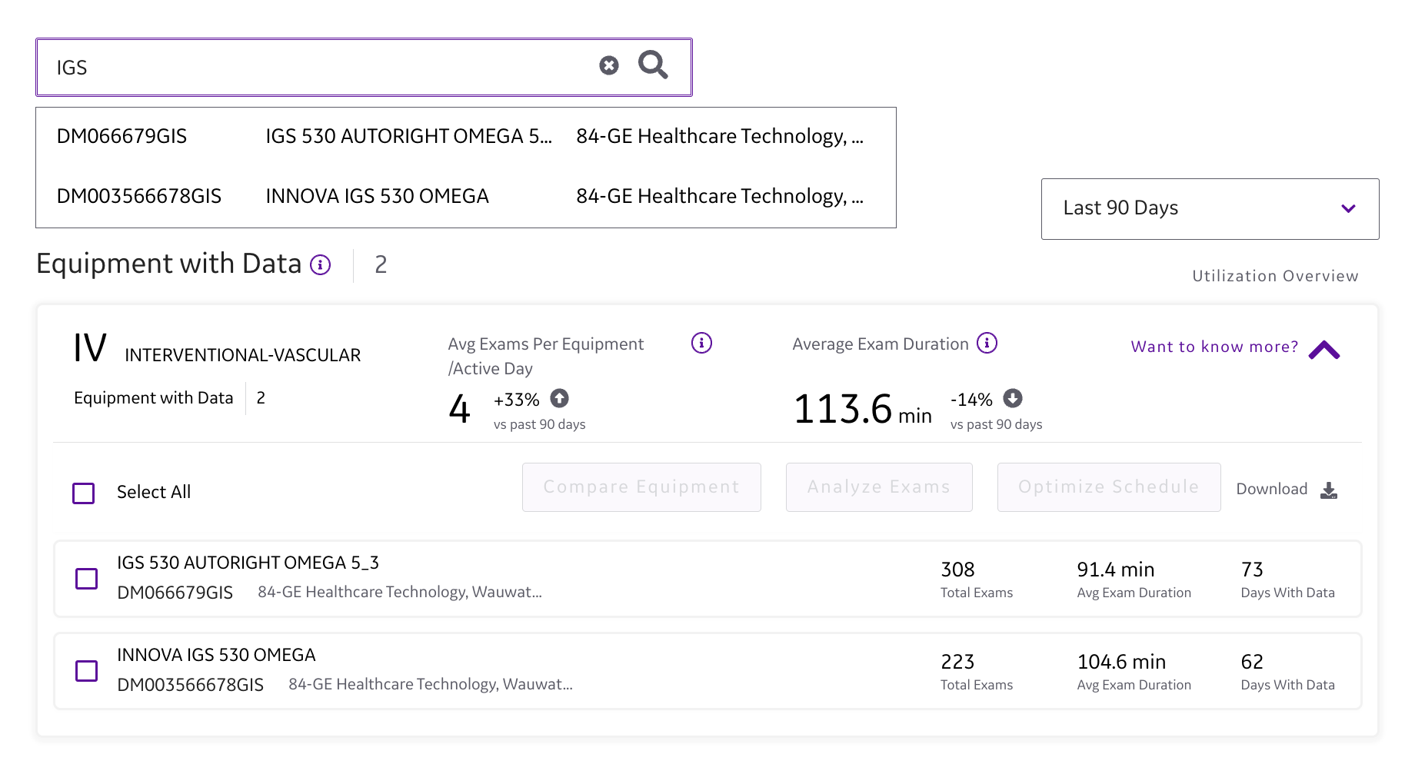
Optimize Imaging Workflow / Utilization
Utilization Comparison
!
You can now see a comparison of the equipment usage within a modality over a specified period. There are two view options available:
Report view: full view of all assets
Comparison view: compare like assets within your account
How to view the Utilization Reports:
Click Reports
Click Utilization Report
Available for Diagnostic Imaging Equipment and Desktop only

Slide 25
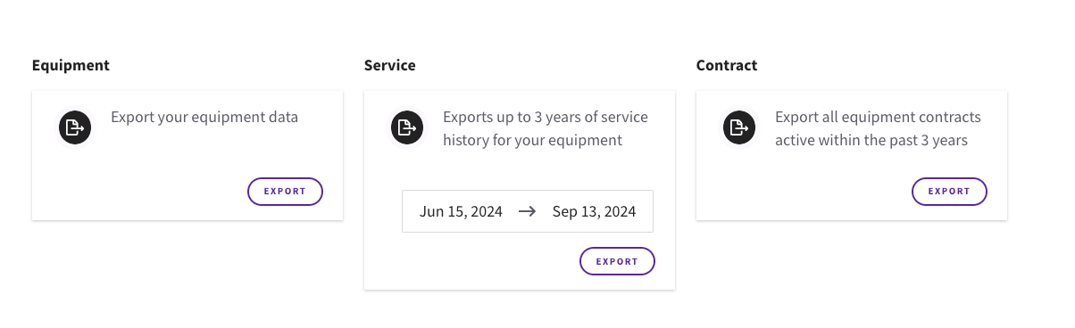
Export Raw Data
Export Raw Data
You can export raw data for the following into .csv format:
Equipment Inventory
Service history
Contract
Available on desktop only
!

Slide 26
Service Solutions
Universal™ Full-Service Solutions
Outsource/Full-Service Contracts
Optimize the performance and operational costs of your healthcare equipment and stay ahead of challenges with a complete solution.
Universal
Making the most of your budget to optimize your total cost of ownership.
Sufficient uptime
Prompt response
Basic parts coverage
Universal Standard
Balancing efficiency and budget to keep you running with quick response time.
High uptime
Quick response
Predictive services²
Full parts replacement coverage
Service support for your assets including:
1
Remote support for troubleshooting, repair and fix¹
2
Proactive & predictive monitoring ²
Universal Plus
When you need complete confidence that your operations are in the very best hands.
Maximum uptime
Rapid response
Predictive services²
Full parts replacement coverage
3
Manage service and support in one place through MyGEHealthCare portal & app
4
Clinical training support
Not applicable to every service event
On Eligible Systems
29

Slide 27
Service Solutions
Unite™ In-House Service Solutions
In-House Service Contracts
Enabling clients committed to an in-house service model
Unite
When you need us, we’re here with quality GE HealthCare parts and the experts to keep you running. The right answer at the right time.
Remote digital collaboration with advanced
visual support
Technical service package
Parts and labor discounts
Two-day shipping
Continued support including:
1
Remote support for troubleshooting, repair and fix¹
2
Augmented reality enabled real-time collaboration
Unite Plus
Stay a step ahead with us as your support system,
working to keep you working with maximum efficiency.
Remote digital collaboration with advanced
visual support
Technical service package
Full parts coverage
Rapid shipping
Labor discounts
3
Technical service packages
4
Ongoing training
5
Proactive & Predictive monitoring²
29
Not applicable to every service event
On Eligible Systems
30

Slide 28
Service Solutions
Planned maintenance solutions
Planned Maintenance
Onsite coverage hours
PM hours: Mon-Fri, 8am–5pm
Count on service that’s built around your schedule — and delivered by experienced engineers who help you maintain high uptime and equipment performance.
Accrediting bodies like ACR, AIUM, IAC require annual Planned Maintenance for accreditation
Other
Basic parts coverage
PM parts only
Parts shipping (Repair & PM parts/specialty if included)
Next day morning (10:30am LST)
Pools
Able to purchase a dollar pool
Includes
PM parts
InSite™ Remote Diagnostics with Advanced
Visual Support¹
MyGEHealthCare: Detailed service records (parts & back-up labor), and contract summary information
Billed at HBS rates
29
31

Slide 29

Service Solutions
A revolutionary new approach
MTAS unites leadership teams and drives synergies under a transformational, agnostic medical technology strategy built on eight disciplines of proven services.
29

Slide 30
Service Solutions
Technology
Enabling success now
and in the future.
Optimization
Powerful driving forces
The eight facets of MTAS are driven by three powerful forces.
Change management
with lifecycle continuous improvement.
Process
Establishing a sustainable process and uniformity.
People
The right leadership, training, and expertise.
29
33

Slide 31
Training

Slide 32
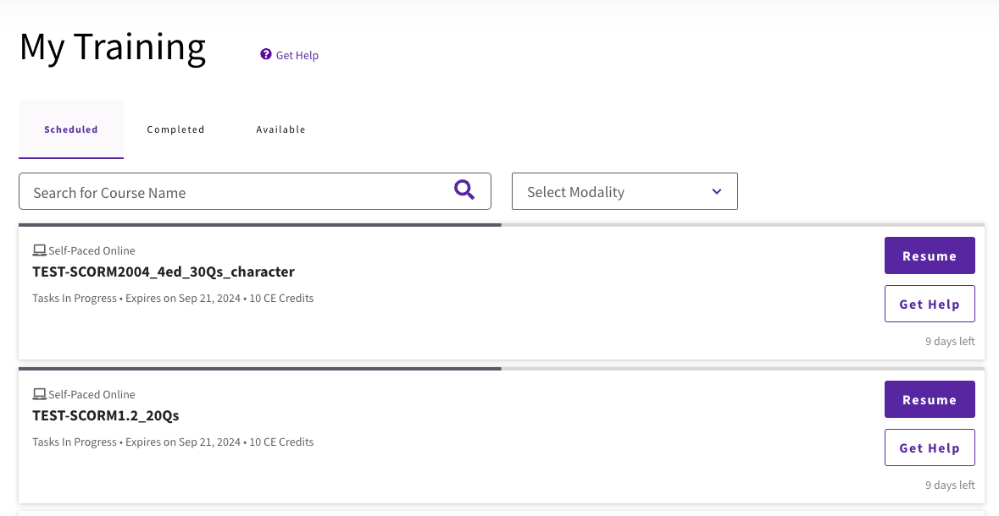
MyGEHealthCare Training
Training
Click Training to access:
Healthcare Learning System
Clinical Education
Technical Training
Digital Expert
Manuals
Cleaning Information
!

Slide 33
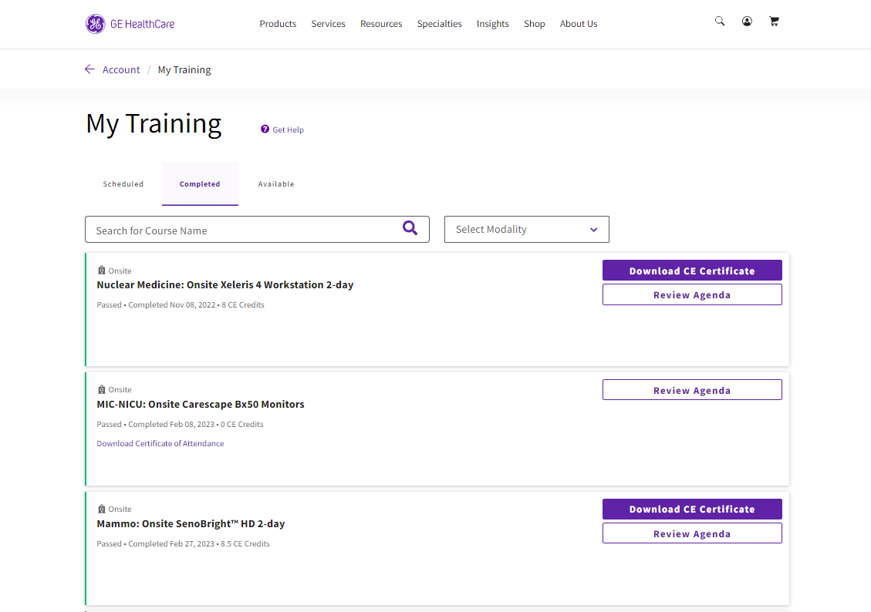
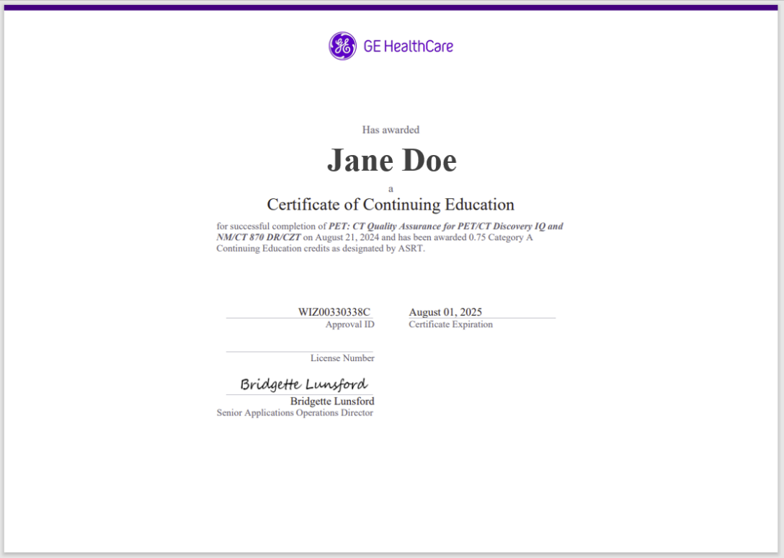
MyGEHealthCare Training
Completed courses
Certificate

Slide 34
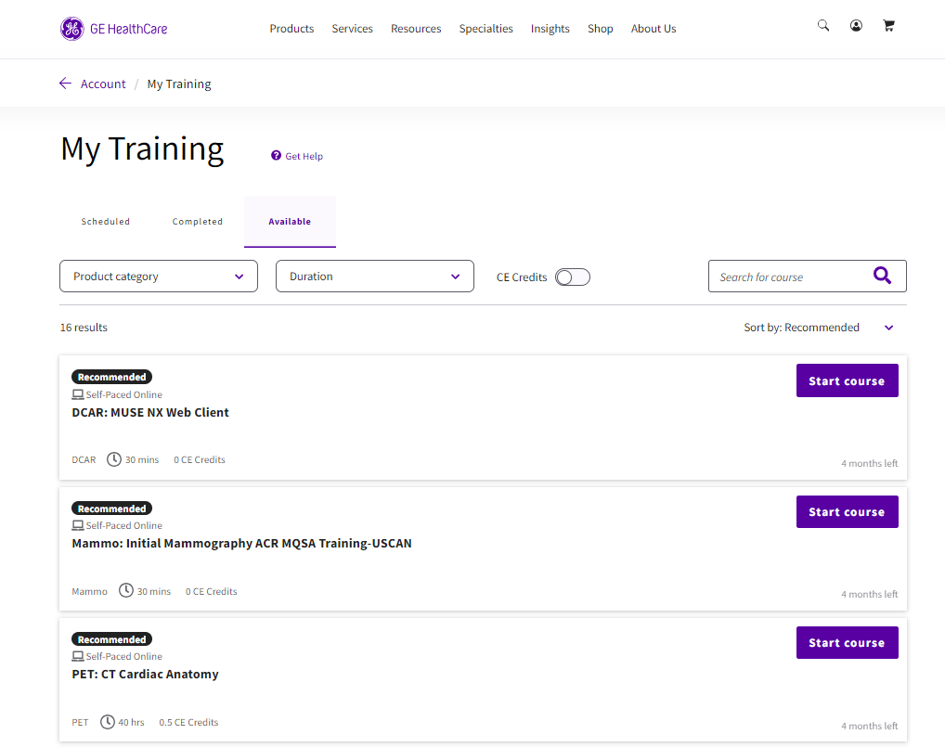
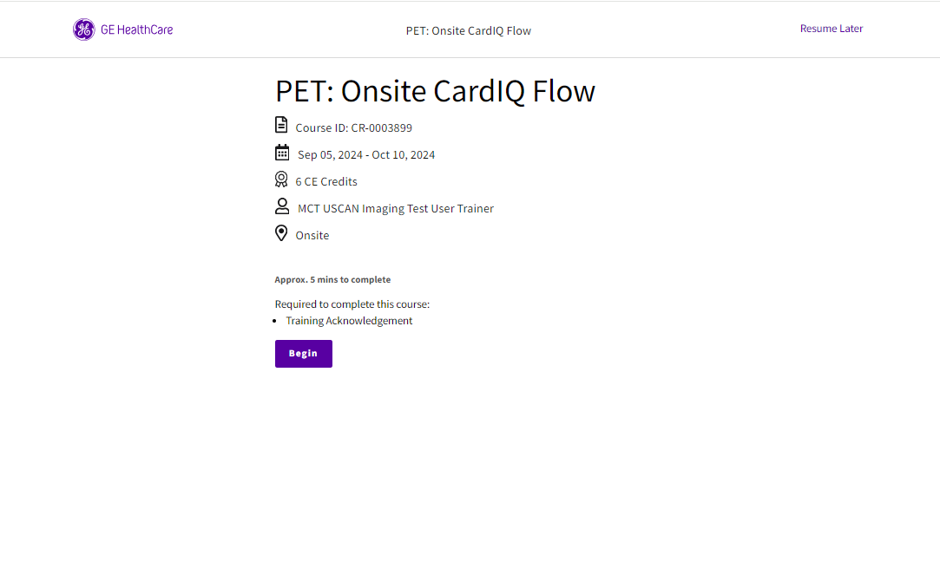
MyGEHealthCare Training
Course Intro page
Available tab

Slide 35
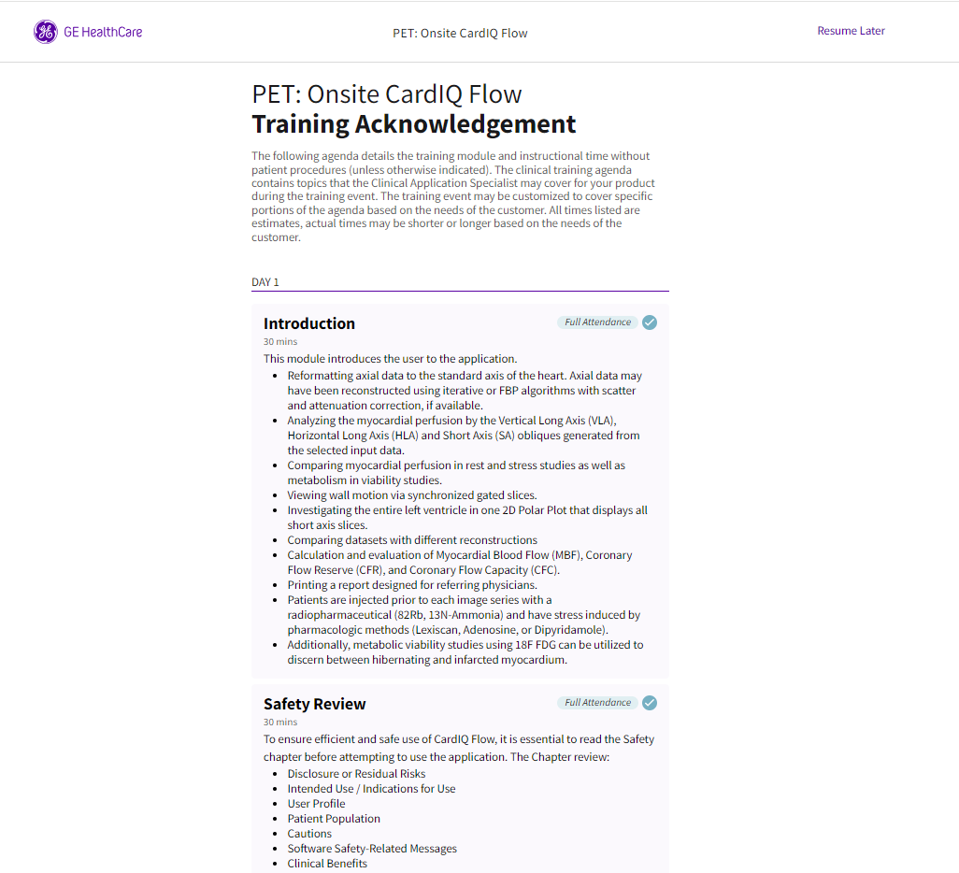
MyGEHealthCare Training
Training Acknowledgement

Slide 36
Orders & Billing

Slide 37
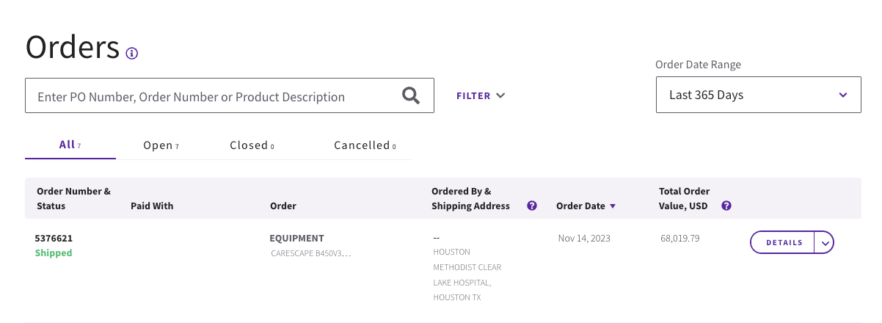

Track Orders
Track Orders
Click Track Orders to view all orders logged on the account, separated by status:
All
Open
Closed
Cancelled
!

Slide 38
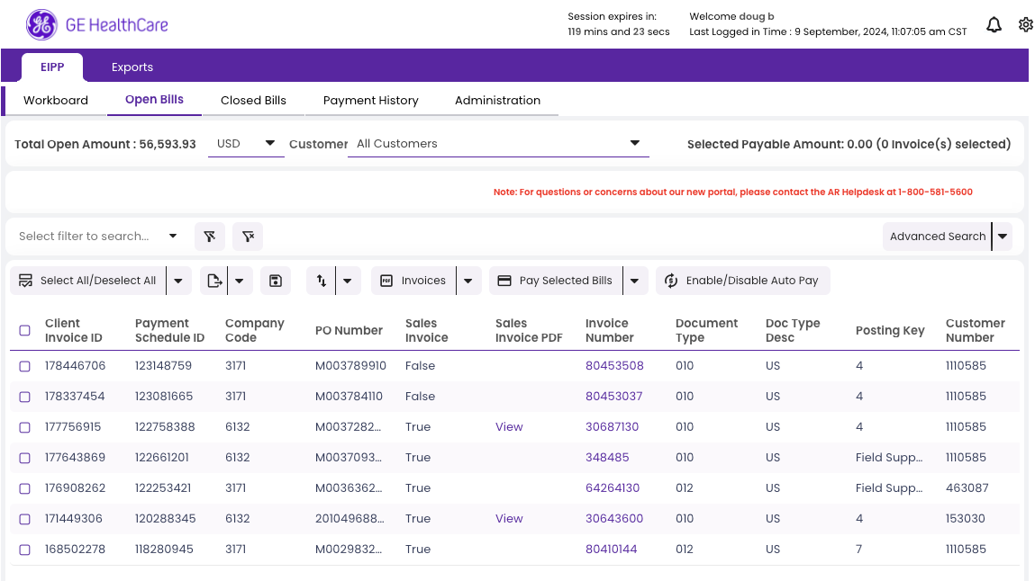
Pay Invoices
Pay Invoices
Click Pay Invoices to pay or review invoices
!

Slide 39
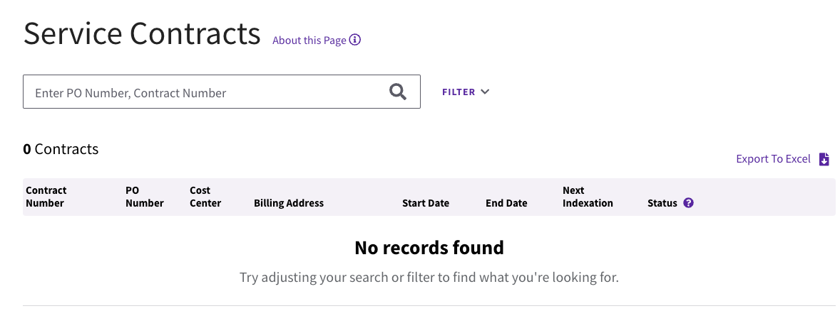
View Service Contracts
Service Contract
Click View Service Contracts to view all service contracts
All
Open
Closed
Cancelled
!

Slide 40
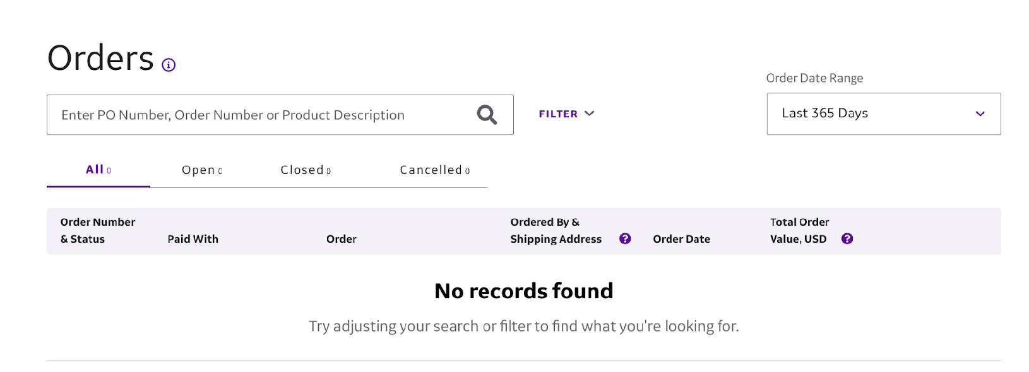

Shop
Shop
Access all the benefits of a top OEM medical equipment provider in one place with GE HealthCare, offering everything from capital equipment and supplies to essential training and customer support to ensure your equipment operates optimally.
!

Slide 41
Product Security

Slide 42
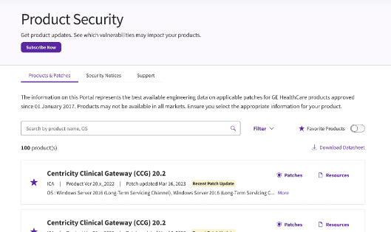
MyGEHealthCare Security
Security
Click Check Cyber Updates to access patches and security resources for our products.
!

Slide 43
Notifications

Slide 44
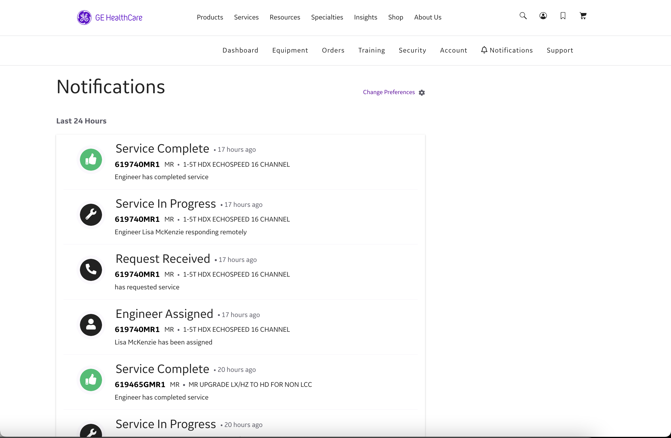
MyGEHealthCare Notifications
Notifications
Click Notifications beside the bell icon to view detailed information on all recent alerts in a scrollable list.

Slide 45
MyGEHealthCare Notifications
How to change Notifications settings:
Select Change Preferences beside the gear icon
1

Slide 46
MyGEHealthCare Notifications
How to change Notifications settings:
Selecting Change Preferences takes you to the Communications tab under Account information.
Use the Edit buttons at the right to change your notification settings.
2

Slide 47
Fleet Management

Slide 48










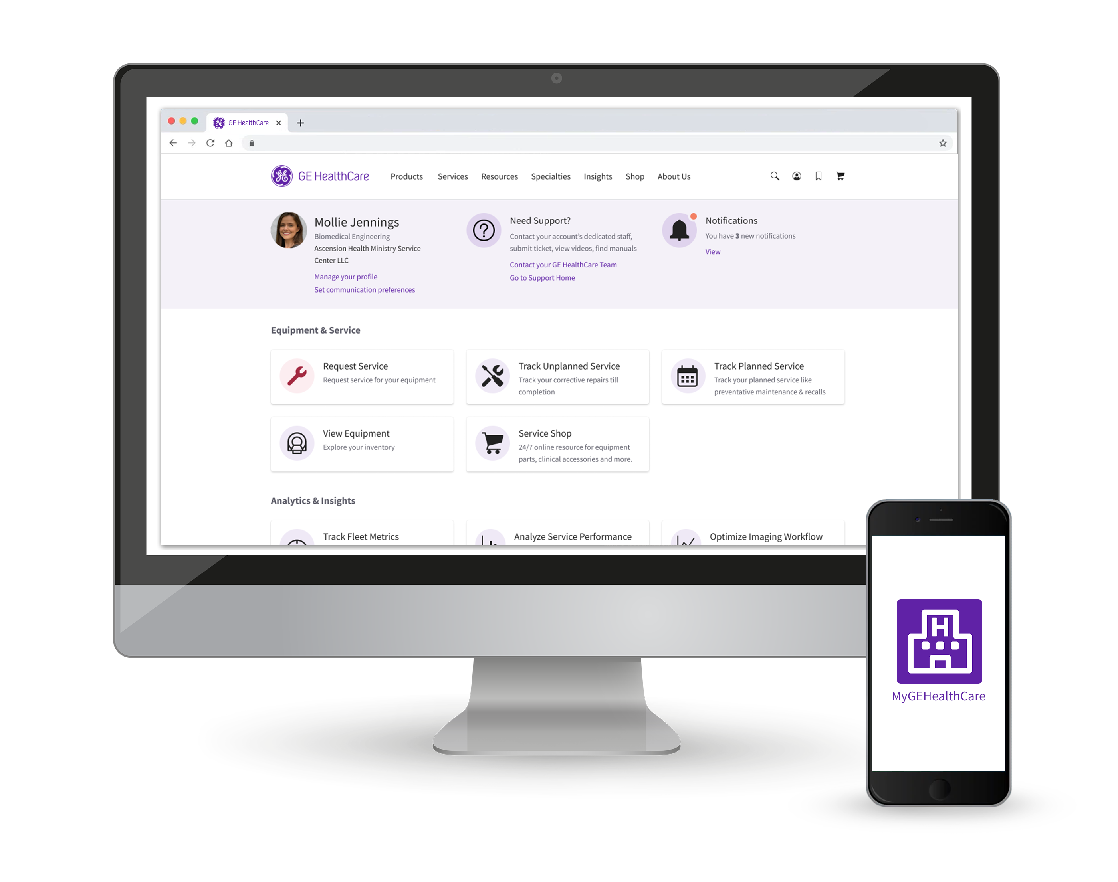
Fleet Management
Service delivery
Lifecycle management
Analytics
Digital delivery
Smart Dispatch
Remote Diagnostics
iLinq™
Predictive monitoring
OnWatch™
Tube Watch*
Real time apps
MyGEHealthCare
Cybersecurity
Skeye™
Continuity™
Standard
Lifecycle management
Continuity™ Suite
• Operating Systems updates
and patching software
upgrades and enabling
hardware
Revive*/Refresh* solutions
• Additional Hardware and
software options
Platforms upgrades
• Mid-life and Lift upgrades
Education
GE HealthCare Cares (EU)
Clinical education
On site and remote
Expert Live Support
Analytics
MyGEHealthCare
iCenter™
DoseWatch™
Remote equipment access and support
Helps to avoid patient care disruption during invasive procedures
Equipment
fleet visibility
To protect devices that enable patient care
To keep systems technologically and clinically up-to-date
Clinical content
and support
Systems utilization metrics to help improve operational
performance
The future is now — enabled by a digital suite.
* Not all products and solutions may be available in your country and for all interventional products. Some
specific conditions may also apply. Please contact a GE HealthCare representative to confirm availability.
48

Slide 49
GE HealthCare reserves the right to make changes in specifications and features shown herein or discontinue the product described at any time without notice or obligation. Contact your GE HealthCare representative for the most current information.
InSite is a trademark of GE HealthCare.
© 2024 GE HealthCare. GE is a trademark of General Electric Company used under trademark license..
JB19621XX

